Slide 1
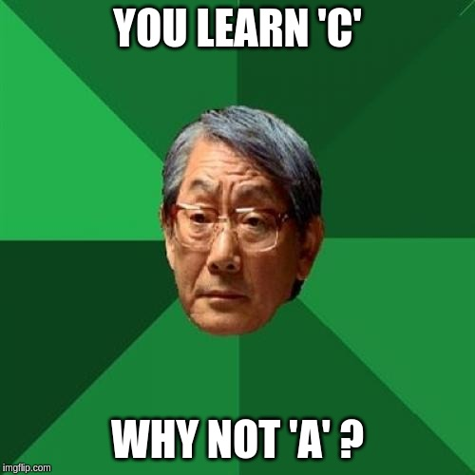
AlexACM | C Programming Language

Slide 2
Let’s start with some concepts, Geeks!

Slide 3
Binary NS & Decimal NS

Slide 4
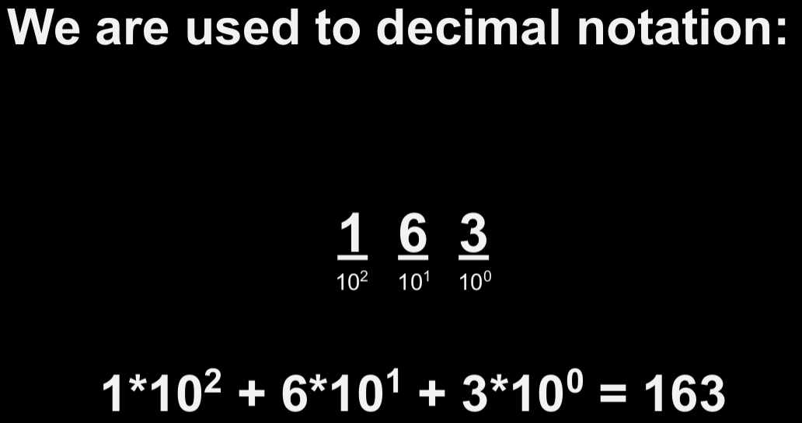
1 2 3

Slide 5
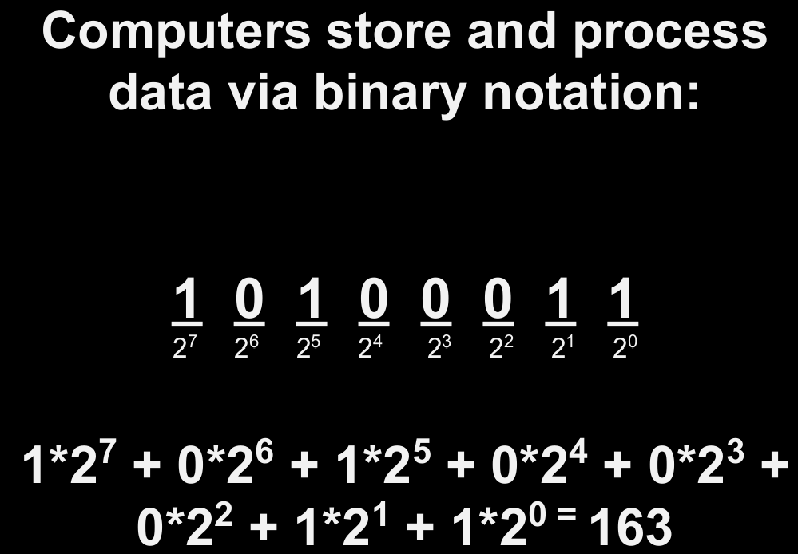
A

Slide 6
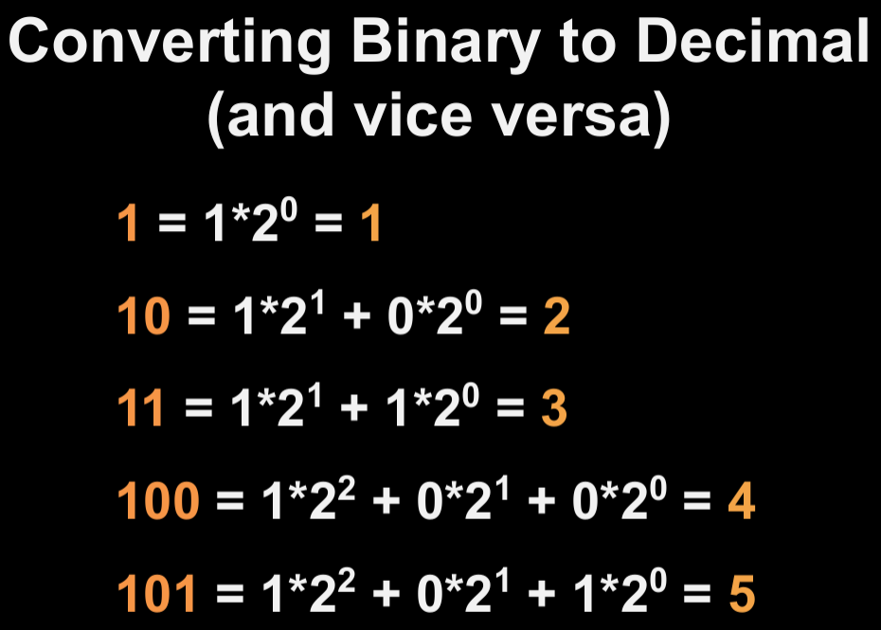
65

Slide 7
ASCII

Slide 8
A | B | C | D | E | F | G | H | I | ...
65 | 66 | 67 | 68 | 69 | 70 | 71 | 72 | 73 | ...

Slide 9
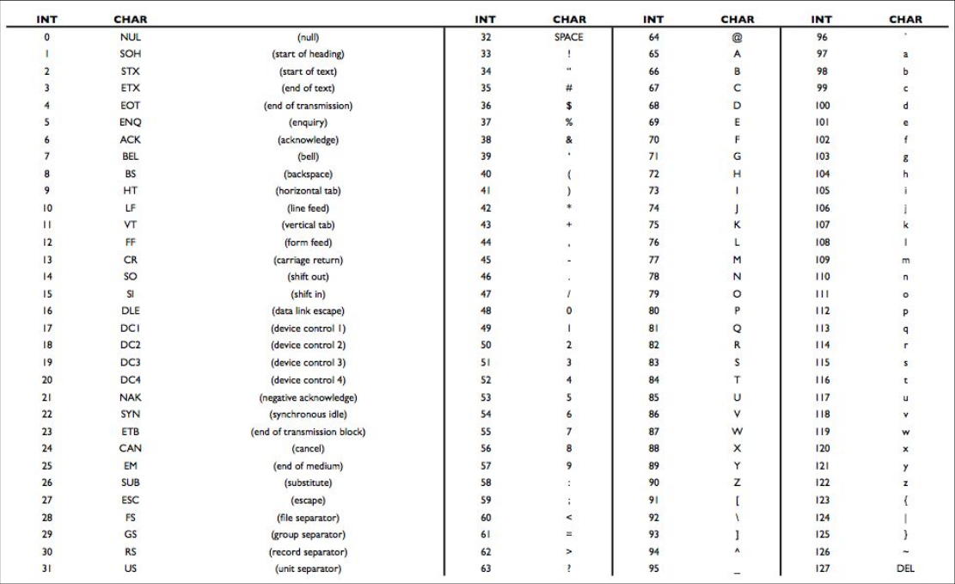
72
73
33

Slide 10
→ output
input →

Slide 11
algorithms

Slide 12
Time Complexity?

Slide 13
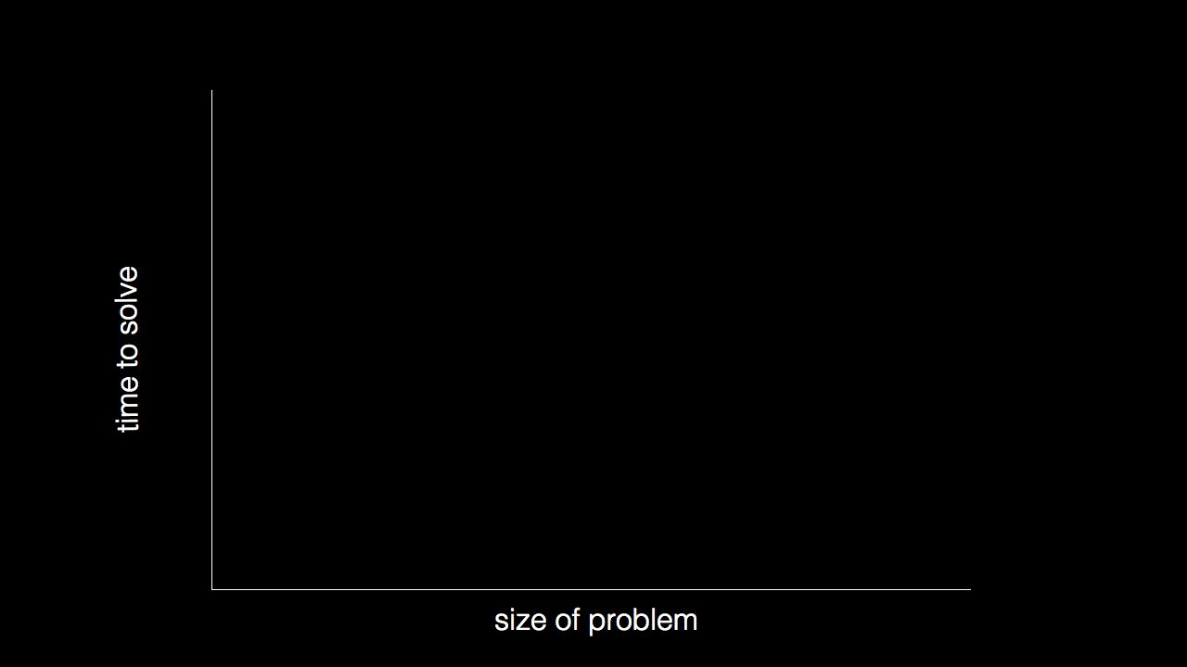

Slide 14
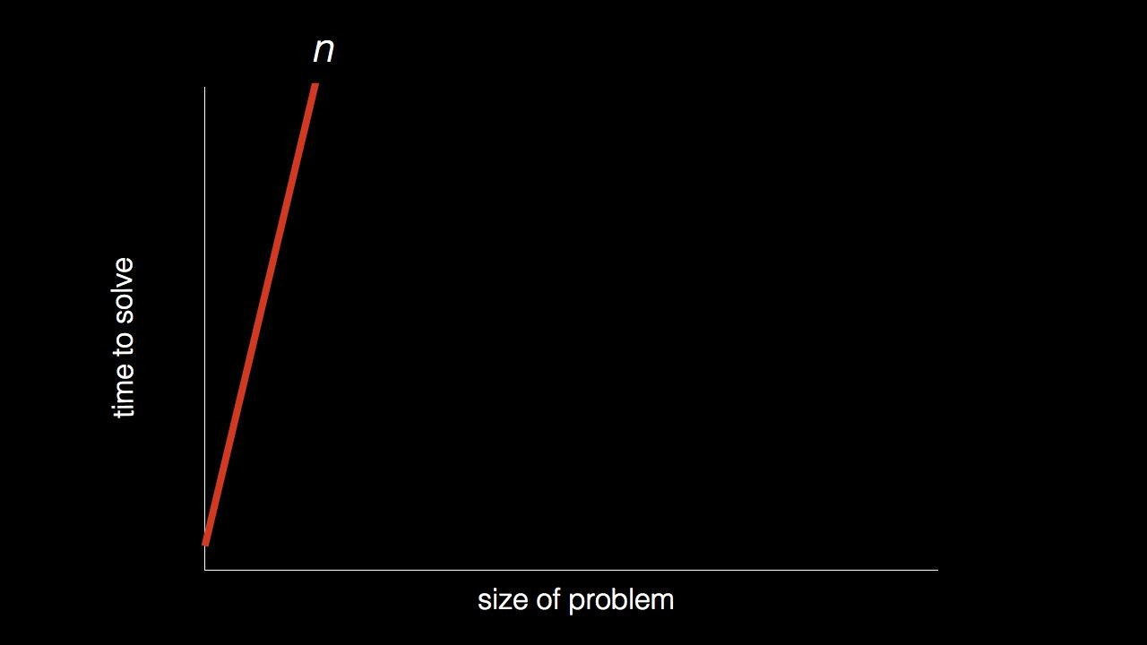

Slide 15
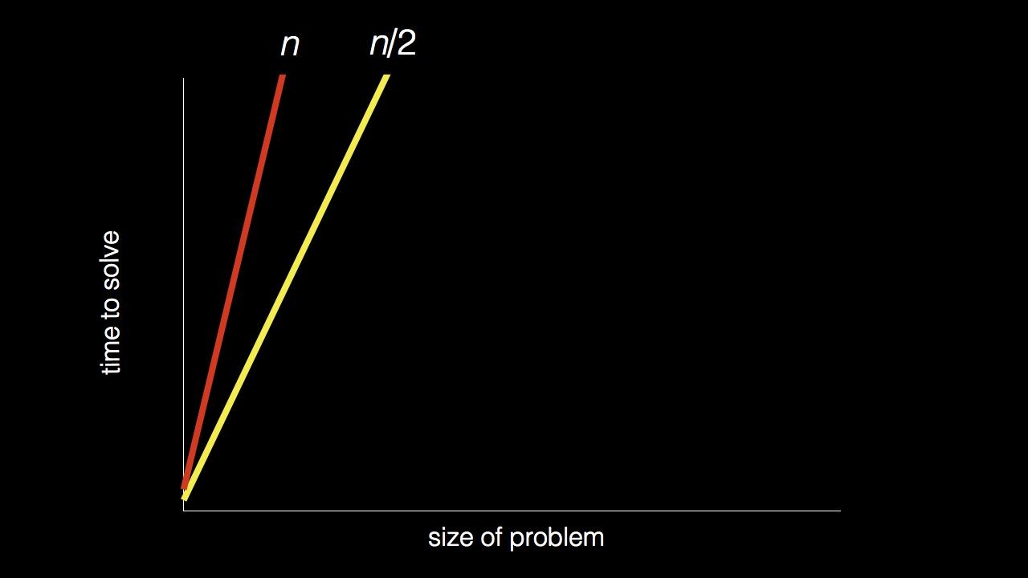

Slide 16
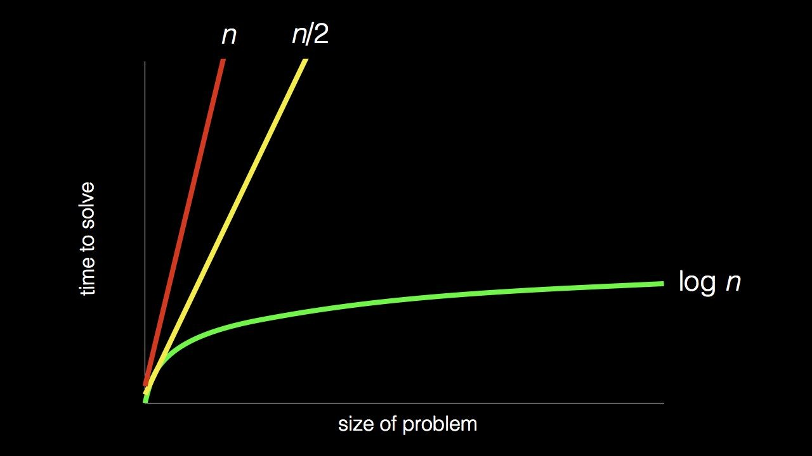

Slide 17
Pseudocode

Slide 18
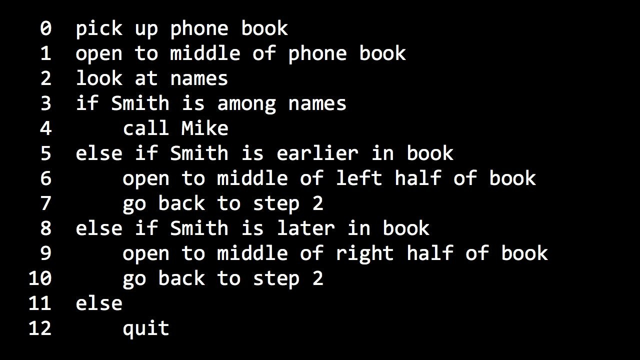

Slide 19
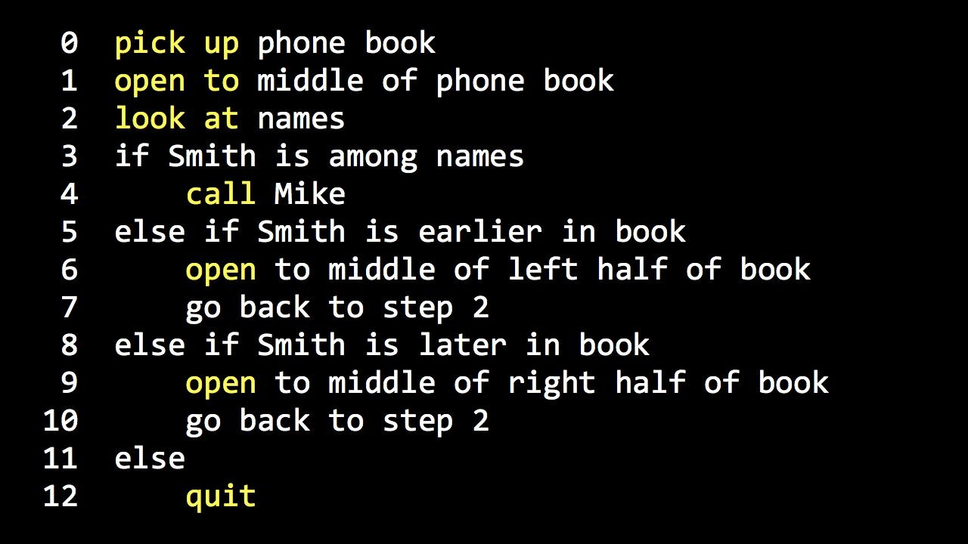

Slide 20
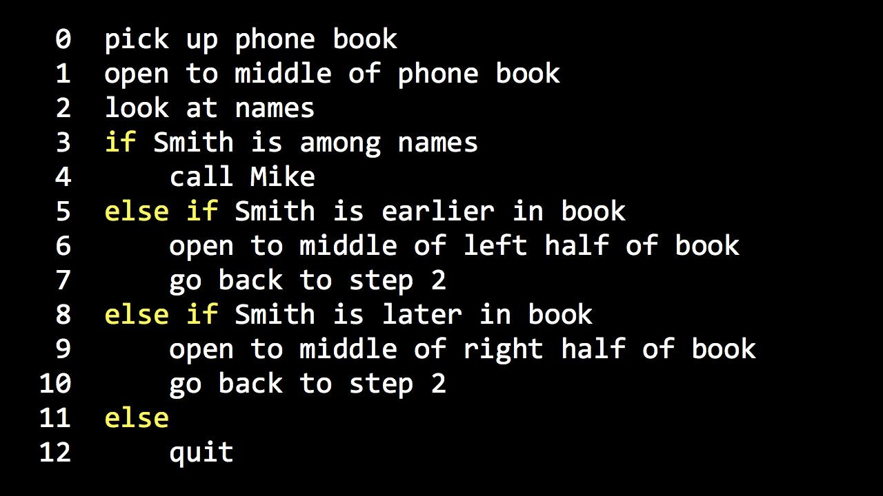

Slide 21
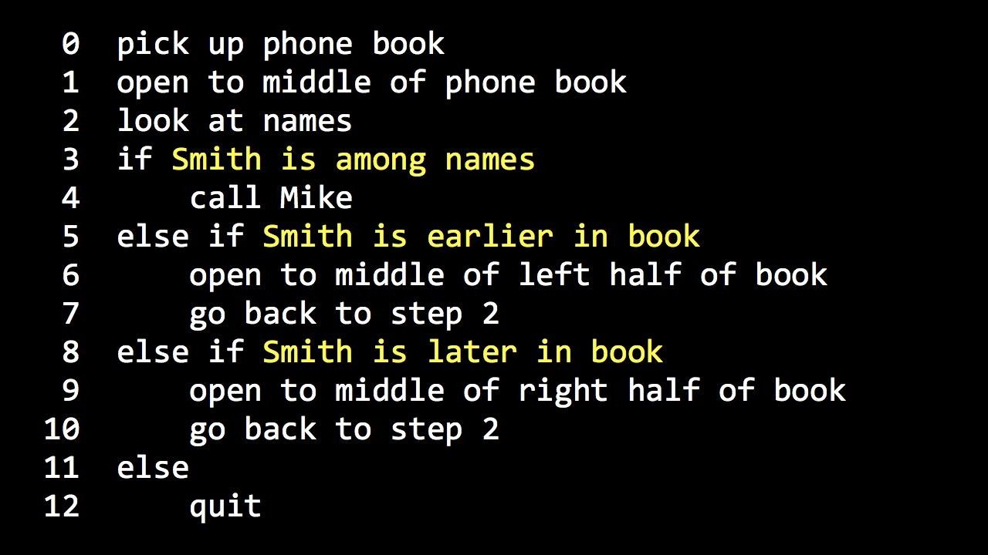

Slide 22
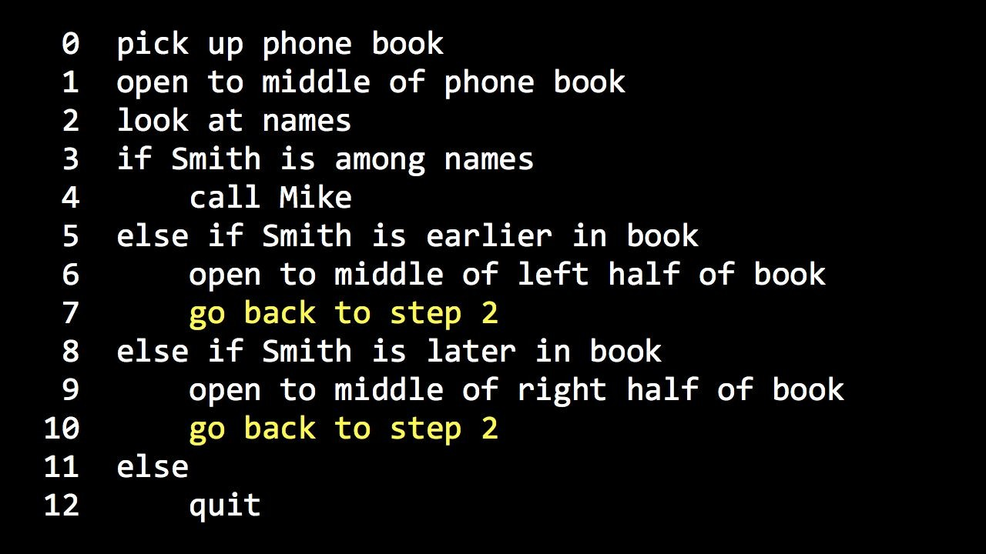

Slide 23
Agenda
Basic Syntax & Data types
Loops
Functions & Recursion
Arrays
Pointers & Memory Management
Strings
Structures
Unions
Bit Fields
File I/O
Preprocessors
Header Files & Error Handling

Slide 24
Questions?

Slide 25
*Fact*
The first high-level programming language was FORTRAN. invented in 1954 by IBM’s John Backus.

Slide 26
C
Basic Syntax

Slide 27
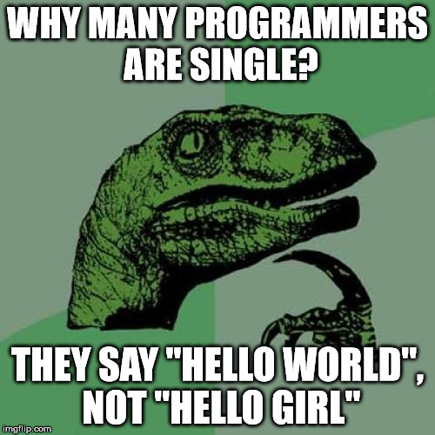
Your first program!
#include <stdio.h>
int main(void)
{
printf("hello, world\n");
}
Notes:
1

Slide 28
Semicolons
printf("Hello, World! \n");
each individual statement must be ended with a semicolon.

Slide 29
Comments
/* my first program in C */
They start with /* and terminate with the characters */ or //
// my first program in C

Slide 30
[a-zA-Z_][a-zA-Z0-9_]*$
case-sensitive
NO keywords
Identifiers
a name used to identify a variable, function, or any other user-defined item.

Slide 31
auto | else | long | switch | double
break | enum | register | typedef
case | extern | return | union
char | float | short | unsigned
const | for | signed | void
continue | goto | sizeof | volatile
default | if | static | while
do | int | struct | _Packed
Keywords
reserved words may not be used as variables or any other identifier names.

Slide 32
C
Data types

Slide 33
Type Storage size Value range
char 1 byte -128 to 127 or 0 to 255
unsigned char 1 byte 0 to 255
signed char 1 byte -128 to 127
int 2 or 4 bytes -32,768 to 32,767 or -2,147,483,648 to 2,147,483,647
unsigned int 2 or 4 bytes 0 to 65,535 or 0 to 4,294,967,295
short 2 bytes -32,768 to 32,767
unsigned short 2 bytes 0 to 65,535
long 8 bytes -9223372036854775808 to 9223372036854775807
unsigned long 8 bytes 0 to 18446744073709551615
char | 1
unsigned char | 1
signed char | 1
int | 4
unsigned int | 4
short | 2
unsigned short | 2
long | 8
unsigned long | 8
Basic types
Integer types

Slide 34
Type Storage size Value range
char 1 byte -128 to 127 or 0 to 255
unsigned char 1 byte 0 to 255
signed char 1 byte -128 to 127
int 2 or 4 bytes -32,768 to 32,767 or -2,147,483,648 to 2,147,483,647
unsigned int 2 or 4 bytes 0 to 65,535 or 0 to 4,294,967,295
short 2 bytes -32,768 to 32,767
unsigned short 2 bytes 0 to 65,535
long 8 bytes -9223372036854775808 to 9223372036854775807
unsigned long 8 bytes 0 to 18446744073709551615
Basic types
float | 4
double | 8
long double | 10
Floating types

Slide 35
Type Storage size Value range
char 1 byte -128 to 127 or 0 to 255
unsigned char 1 byte 0 to 255
signed char 1 byte -128 to 127
int 2 or 4 bytes -32,768 to 32,767 or -2,147,483,648 to 2,147,483,647
unsigned int 2 or 4 bytes 0 to 65,535 or 0 to 4,294,967,295
short 2 bytes -32,768 to 32,767
unsigned short 2 bytes 0 to 65,535
long 8 bytes -9223372036854775808 to 9223372036854775807
unsigned long 8 bytes 0 to 18446744073709551615
%d | Integer
%f | Float
%c | Character
%s | String **Note**
%u | Unsigned Integer
%ld | Long Int
Format
There are mostly six types of format specifiers that are available in C.

Slide 36
Type Storage size Value range
char 1 byte -128 to 127 or 0 to 255
unsigned char 1 byte 0 to 255
signed char 1 byte -128 to 127
int 2 or 4 bytes -32,768 to 32,767 or -2,147,483,648 to 2,147,483,647
unsigned int 2 or 4 bytes 0 to 65,535 or 0 to 4,294,967,295
short 2 bytes -32,768 to 32,767
unsigned short 2 bytes 0 to 65,535
long 8 bytes -9223372036854775808 to 9223372036854775807
unsigned long 8 bytes 0 to 18446744073709551615
\a | beep sound
\b | backspace
\f | form feed
\n | new line
\t | horizontal tab
\v | vertical tab
\' | single quote
\" | double quote
Constants
character constants

Slide 37
Questions?

Slide 38
C
Operators

Slide 39
Type Storage size Value range
char 1 byte -128 to 127 or 0 to 255
unsigned char 1 byte 0 to 255
signed char 1 byte -128 to 127
int 2 or 4 bytes -32,768 to 32,767 or -2,147,483,648 to 2,147,483,647
unsigned int 2 or 4 bytes 0 to 65,535 or 0 to 4,294,967,295
short 2 bytes -32,768 to 32,767
unsigned short 2 bytes 0 to 65,535
long 8 bytes -9223372036854775808 to 9223372036854775807
unsigned long 8 bytes 0 to 18446744073709551615
+ | Addition
- | Subtraction
* | Multiplication
/ | Division
% | Modulus
Arithmetic
are used to performing mathematical calculations

Slide 40
Type Storage size Value range
char 1 byte -128 to 127 or 0 to 255
unsigned char 1 byte 0 to 255
signed char 1 byte -128 to 127
int 2 or 4 bytes -32,768 to 32,767 or -2,147,483,648 to 2,147,483,647
unsigned int 2 or 4 bytes 0 to 65,535 or 0 to 4,294,967,295
short 2 bytes -32,768 to 32,767
unsigned short 2 bytes 0 to 65,535
long 8 bytes -9223372036854775808 to 9223372036854775807
unsigned long 8 bytes 0 to 18446744073709551615
Inc & Dec
++ | Inc
-- | Dec
Increment and Decrement Operators.

Slide 41
Type Storage size Value range
char 1 byte -128 to 127 or 0 to 255
unsigned char 1 byte 0 to 255
signed char 1 byte -128 to 127
int 2 or 4 bytes -32,768 to 32,767 or -2,147,483,648 to 2,147,483,647
unsigned int 2 or 4 bytes 0 to 65,535 or 0 to 4,294,967,295
short 2 bytes -32,768 to 32,767
unsigned short 2 bytes 0 to 65,535
long 8 bytes -9223372036854775808 to 9223372036854775807
unsigned long 8 bytes 0 to 18446744073709551615
== | Is equal to
!= | Is not equal to
> | Greater than
< | Less than
>= | Greater than or equal to
<= | Less than or equal to
Relational
used to comparing two quantities or values.

Slide 42
Type Storage size Value range
char 1 byte -128 to 127 or 0 to 255
unsigned char 1 byte 0 to 255
signed char 1 byte -128 to 127
int 2 or 4 bytes -32,768 to 32,767 or -2,147,483,648 to 2,147,483,647
unsigned int 2 or 4 bytes 0 to 65,535 or 0 to 4,294,967,295
short 2 bytes -32,768 to 32,767
unsigned short 2 bytes 0 to 65,535
long 8 bytes -9223372036854775808 to 9223372036854775807
unsigned long 8 bytes 0 to 18446744073709551615
&& | And operator.
|| | Or operator.
! | Not operator.
Logical
C provides three logical operators

Slide 43
Type Storage size Value range
char 1 byte -128 to 127 or 0 to 255
unsigned char 1 byte 0 to 255
signed char 1 byte -128 to 127
int 2 or 4 bytes -32,768 to 32,767 or -2,147,483,648 to 2,147,483,647
unsigned int 2 or 4 bytes 0 to 65,535 or 0 to 4,294,967,295
short 2 bytes -32,768 to 32,767
unsigned short 2 bytes 0 to 65,535
long 8 bytes -9223372036854775808 to 9223372036854775807
unsigned long 8 bytes 0 to 18446744073709551615
<< | Binary Left Shift Operator
>> | Binary Right Shift Operator
~ | Binary Ones Complement Operator
& | Binary AND Operator
^ | Binary XOR Operator
| | Binary OR Operator
<< | Binary Left Shift Operator
>> | Binary Right Shift Operator
~ | Binary Ones Complement Operator
Bitwise
C provides a special operator for bit operation between two variables.

Slide 44
Type Storage size Value range
char 1 byte -128 to 127 or 0 to 255
unsigned char 1 byte 0 to 255
signed char 1 byte -128 to 127
int 2 or 4 bytes -32,768 to 32,767 or -2,147,483,648 to 2,147,483,647
unsigned int 2 or 4 bytes 0 to 65,535 or 0 to 4,294,967,295
short 2 bytes -32,768 to 32,767
unsigned short 2 bytes 0 to 65,535
long 8 bytes -9223372036854775808 to 9223372036854775807
unsigned long 8 bytes 0 to 18446744073709551615
= | Assign
+= | Increments then assign
-= | Decrements then assign
*= | Multiplies then assign
/= | Divides then assign
%= | Modulus then assign
&= | Bitwise AND assign
^= | Bitwise ex OR and assign
|= | Bitwise inclusive OR and assign
Assignment
C has a collection of shorthand assignment operators.

Slide 45
Questions?

Slide 46
*Fact*
The language name C because it succeeds another language called B.

Slide 47


Slide 48
YOU CAN DO IT!
C program to add two integers entered by the User.
C program to multiply two floating-point numbers.
C program to find ASCII value of a character by the user.
C program to find quotient and remainder of Two Integers.
C program to swap two numbers.

